Slide 1
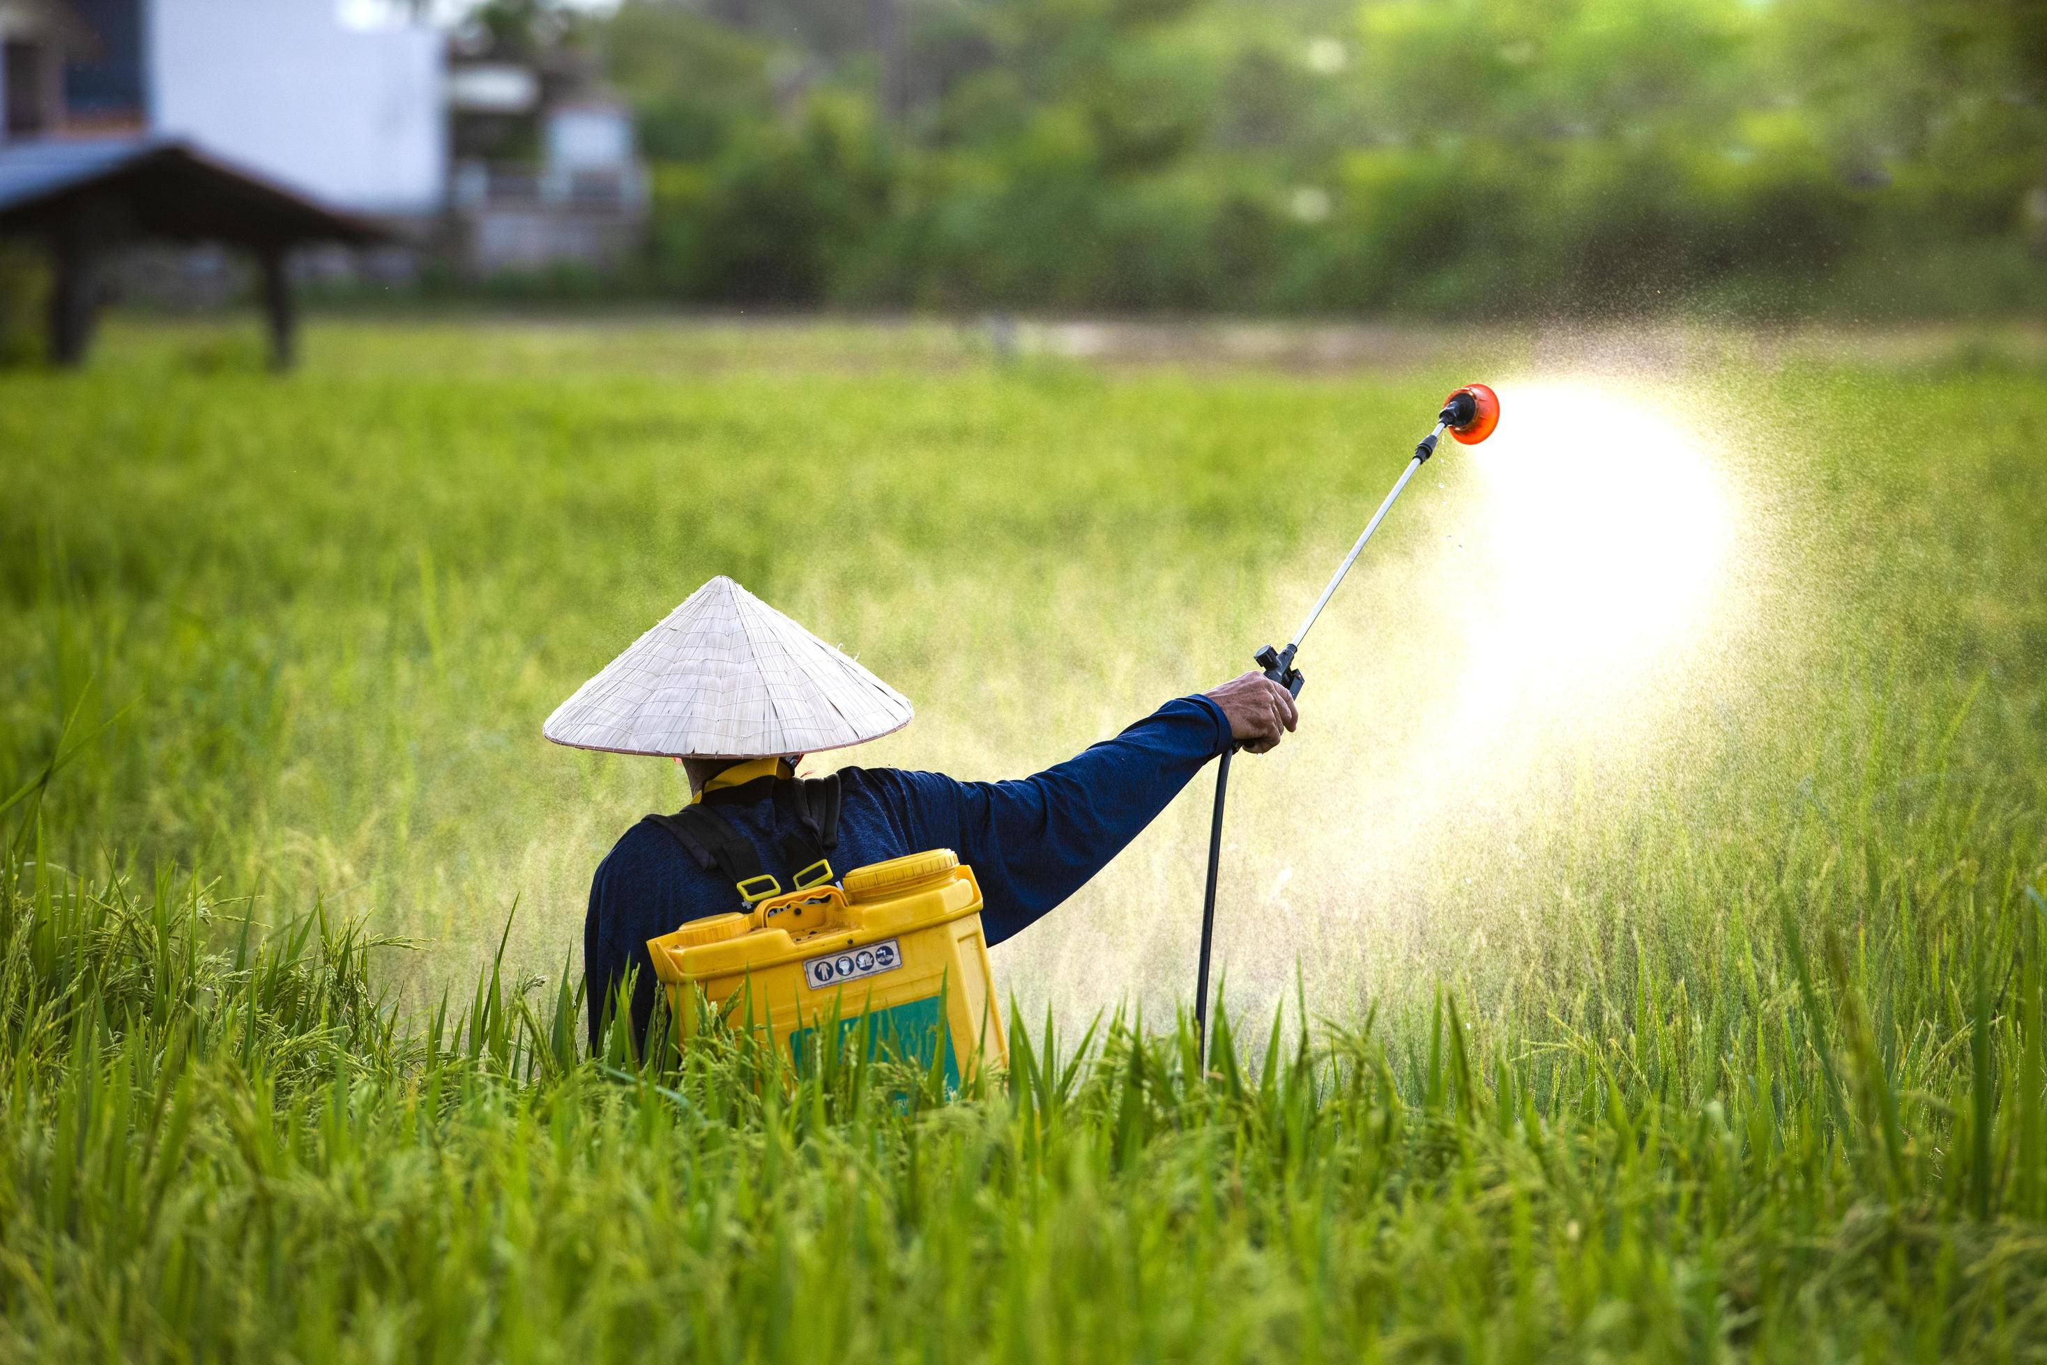

Farmer Friendly Consultancy
VIDYAVARDHAKA POLYTECHNIC MYSORE
Gokulam III Stage Mysore
Problem Statement:
A Real-time, role-based web platform enabling seamless communication and study material sharing between students and faculty.
BG Thejas
Vinay Kumar R
Rayan Ahmed
Pavan S
Guide: Sahana R

Slide 2
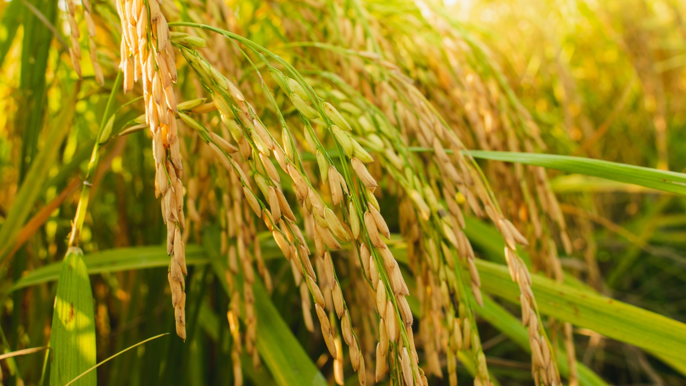
Description of the Problem Statement :
Farmers struggle to get timely and accurate advice on crop selection, fertilizer use, and pest control. There is a need for a smart, accessible platform to provide personalized agricultural recommendations.
Recommend crops based on soil and weather conditions.
Suggest fertilizers based on soil health and crop type.
Identify pests from images and suggest suitable pesticides.

Slide 3
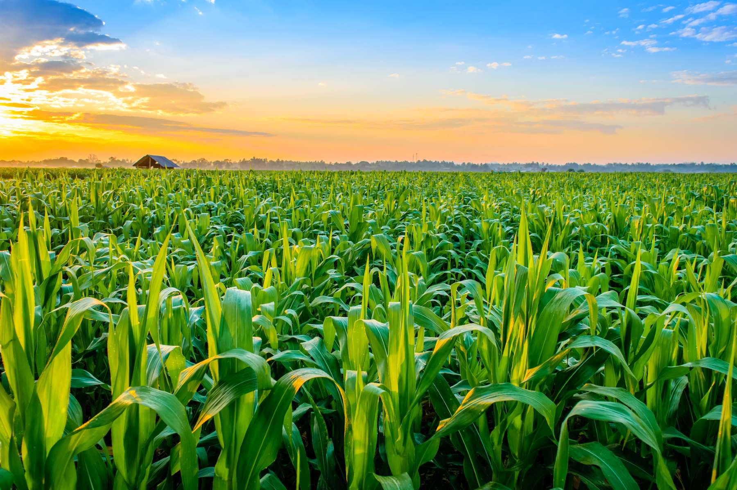
Proposed Solution:
Introduction to the Farmer Friendly Consultancy:
Farmer Friendly Consultancy is a smart web-based platform designed to support farmers by offering data-driven recommendations for crop selection, fertilizer usage, and pest control
Functionality:
Crop Recommendation – Suggests the most suitable crops based on soil nutrients, temperature, humidity, pH, and rainfall.
Fertilizer Suggestion – Recommends fertilizers based on soil health and selected crops.
Pest Detection & Pesticide Recommendation – Uses deep learning to detect pests from images and suggest effective pesticides with usage details.
User Dashboard – Displays past recommendations and allows easy access to results.
Simple Login System – Farmers can log in using mobile number and password.

Slide 4
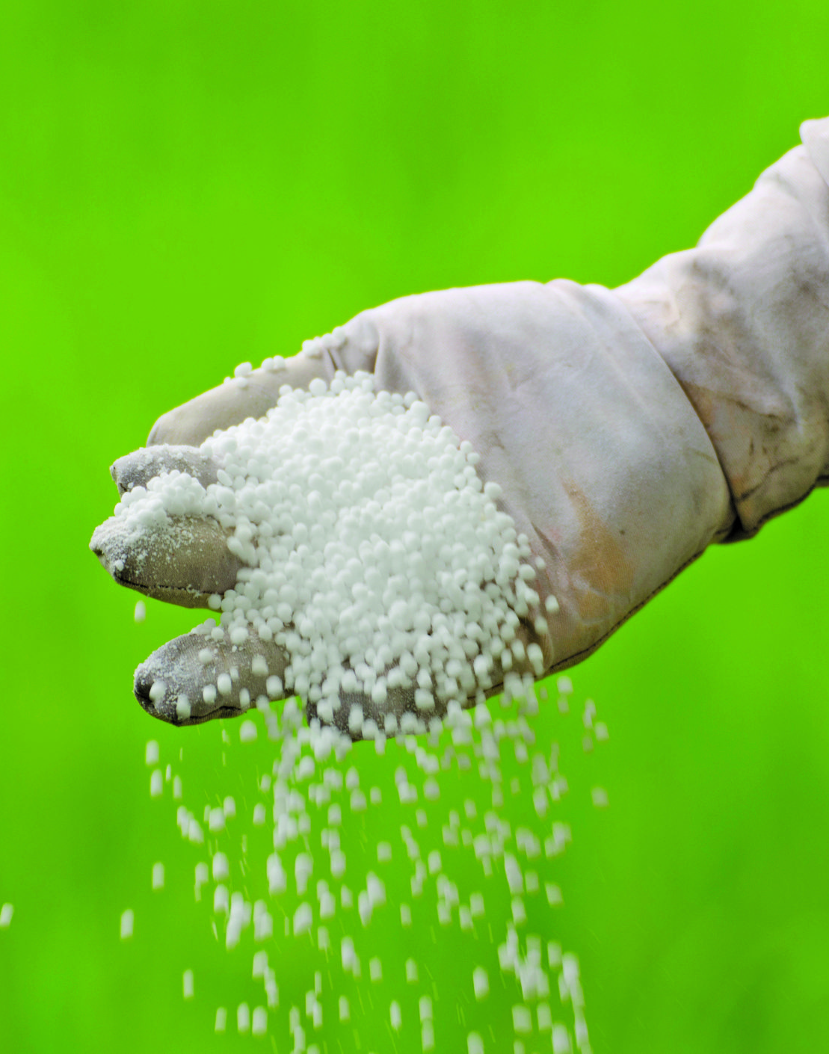
Novelty of the Proposed Solution:
Innovative Aspects:
Machine learning models for crop and pest recommendations based on local conditions.
Integrated system for crop, fertilizer, and pesticide suggestions in one platform.
History of previous recommendations displayed with timestamps for tracking past advice and decisions.

Slide 5
Capstone Project Planning
Work Breakdown Structure (WBS)
Project Initiation and Planning
Define the problem statement, goals, and tools required.
System Design
Design system architecture, frontend interfaces, and backend APIs.
Development
Implement frontend and backend features, including model integration and user history.
Testing
Conduct unit, integration, and UI/UX testing to ensure functionality.
Deployment
Deploy the web app on platforms like PythonAnywhere or Heroku and test end-to-end workflow.
Documentation and Final Report
Write the user manual, document system flow, and prepare the final report.

Slide 6
Timeline Development – Schedule
Week | Task | Description
Weeks 1-2 | Project Initiation & Planning | Requirement analysis, feasibility study, scope finalization, resource planning
Weeks 3–4 | Design | UI/UX wireframes, architecture blueprint, DB schema design, design approval
Weeks 5–9 | Development | Frontend forms, backend APIs, model integration, image preview, MongoDB history module
Weeks 10–11 | Testing | Unit testing, integration testing, bug fixes, responsiveness testing
Week 12 | Deployment | Deployment to server or hosting platform or localhost
Week 13 | Documentation and Presentation | Final report, slide deck, project presentation

Slide 7
Cost Breakdown Structure (CBS)
Component | Quantity | Unit Cost (₹) | Total Cost (₹)
Internet Charges | 3 Months | 2500 | 2500
Domain and Hosting | Per Year | 2,500 | 2,500
Documentation | 4 members | 500 | 2,000
Total Estimated Cost |  |  | ₹7000

Slide 8
Risk Analysis
Risk | Potential Impact | Mitigation Strategy
User input errors | May cause incorrect predictions or system crashes | Add validation checks on all form inputs and informative error messages
User Interface Issues | Users may find the platform confusing to navigate | Conduct user testing and gather feedback for UI improvement and usability fixes.
Inaccurate pesticide image detection | Wrong pest classification can lead to crop damage | Implement a fallback message when confidence is low, allow image re-upload
Delays in development | Missed deadlines, incomplete features | Weekly tracking, Agile sprints with buffers

Slide 9
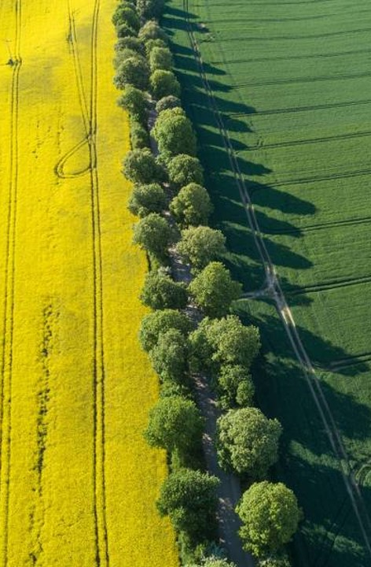
Methodology
Development approach: Agile methodology
Sprints: Divide the project into multiple sprints for interactive development and progress tracking
Key Phases:
Requirement gathering
Designing
Implementation
Testing
Deployment and documentation

Slide 10
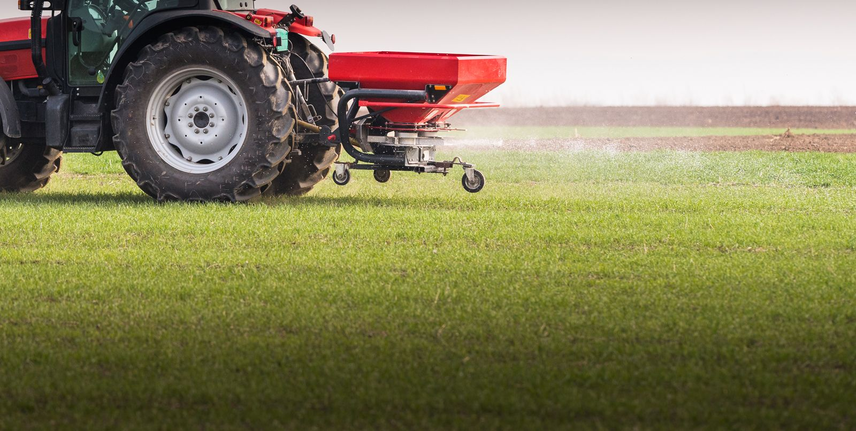
Technology Used
Frontend Technologies: HTML, CSS, JavaScript.
Backend is built with Python Flask framework.
Image classification uses TensorFlow/Keras models.
Data is stored in MongoDB (NoSQL).

Slide 11
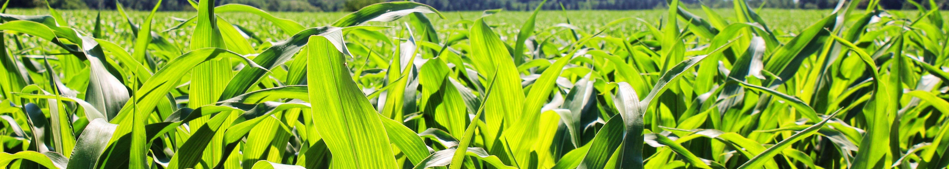
Hardware & Software Requirements
Hardware: PC/Laptop with modern browser
Software: VS Code, MongoDB, Postman, Python environment
Programming Languages
HTML, CSS, JS
Python (Flask + TensorFlow/Keras )

Slide 12
System Components
User Interface: Farmers Interact With The System
Database: Stores Soil Data, Crop Information, And Pesticide Details
Recommendation Engine: Ml-based System For Suggestions
Report Generation: Displays Best Practices And Results

Slide 13
Component Diagram
Start
User Selects a service :
1. Crop Recommendation
2. Fertilizer Recommendation
3. Pesticide Recommendation
Crop Recommendation Flow
Fertilizer Recommendation Flow
Pesticide Recommendation Flow
User Inputs:
- Nitrogen (N) Level
- Phosphorus (P) Level
- Potassium (K) Level
- Temperature (°C)
- Humidity (%)
- Soil pH
- Rainfall (mm)
User Inputs:
- Select Crop
- Nitrogen (N) Level
- Phosphorus (P) Level
- Potassium (K) Level
User Inputs:
- Upload Image of Affected Crop
Process:
- Validate Input
- Process Image Using
Machine Learning Model
- Identify Pest/Disease
Process:
- Validate Inputs
- Compare Soil Nutrients with Crop Needs
- Use ML Model or Rules
Process:
- Validate Inputs
- Use ML Model or
Rule-based Logic
Output:
- Display Detected Pest
- Display Recommended
Pesticide
Output:
- Display Recommended Fertilizer
Output:
- Display Recommended Crop

Slide 14
Testing & Validation
Feature | Test Scenario | Expected Outcome | Status
User Registration | Valid inputs for new user | Account created successfully | ✅ Yes
Login | Correct credentials | User logged in and redirected | ✅ Yes
Crop Recommendation | Valid/Invalid inputs | Crop name and image returned | ✅ Yes
Fertilizer Recommendation | Valid crop and NPK levels | Correct fertilizer suggestion | ✅ Yes
Pesticide Detection | Upload pest images, preview visible | Pest prediction shown if confident | ✅ Yes
History Display | Load history from MongoDB | History will be displayed | ✅ Yes
Logout | Click logout button | Session terminated | ✅ Yes

Slide 15
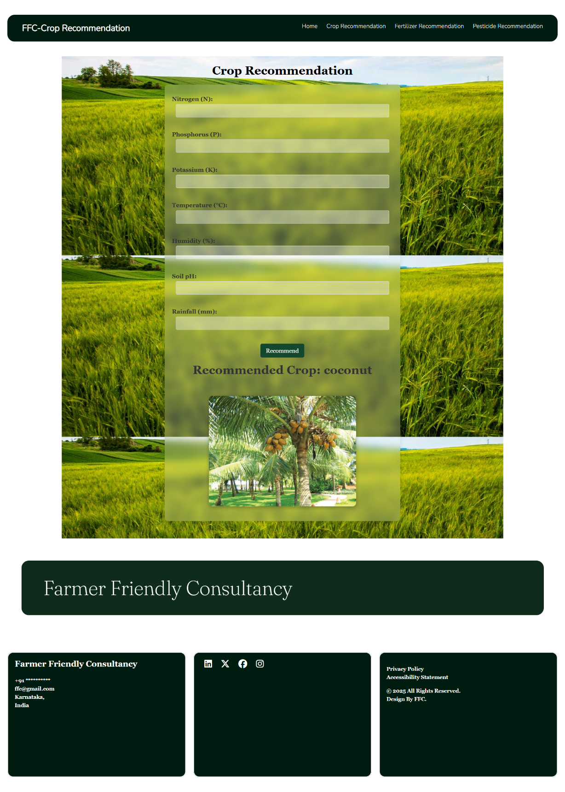
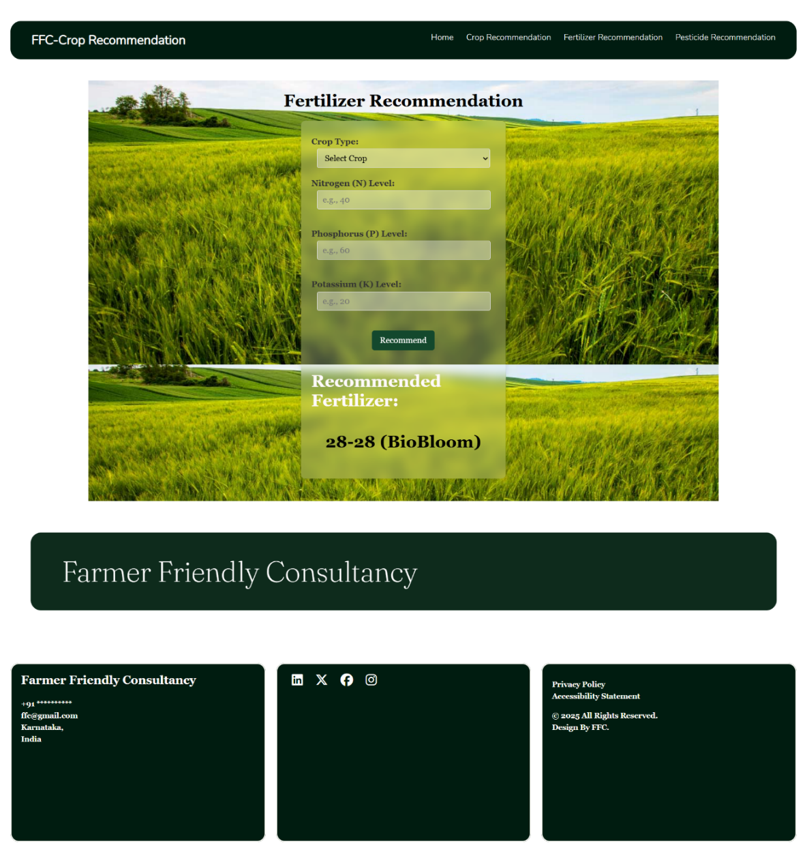
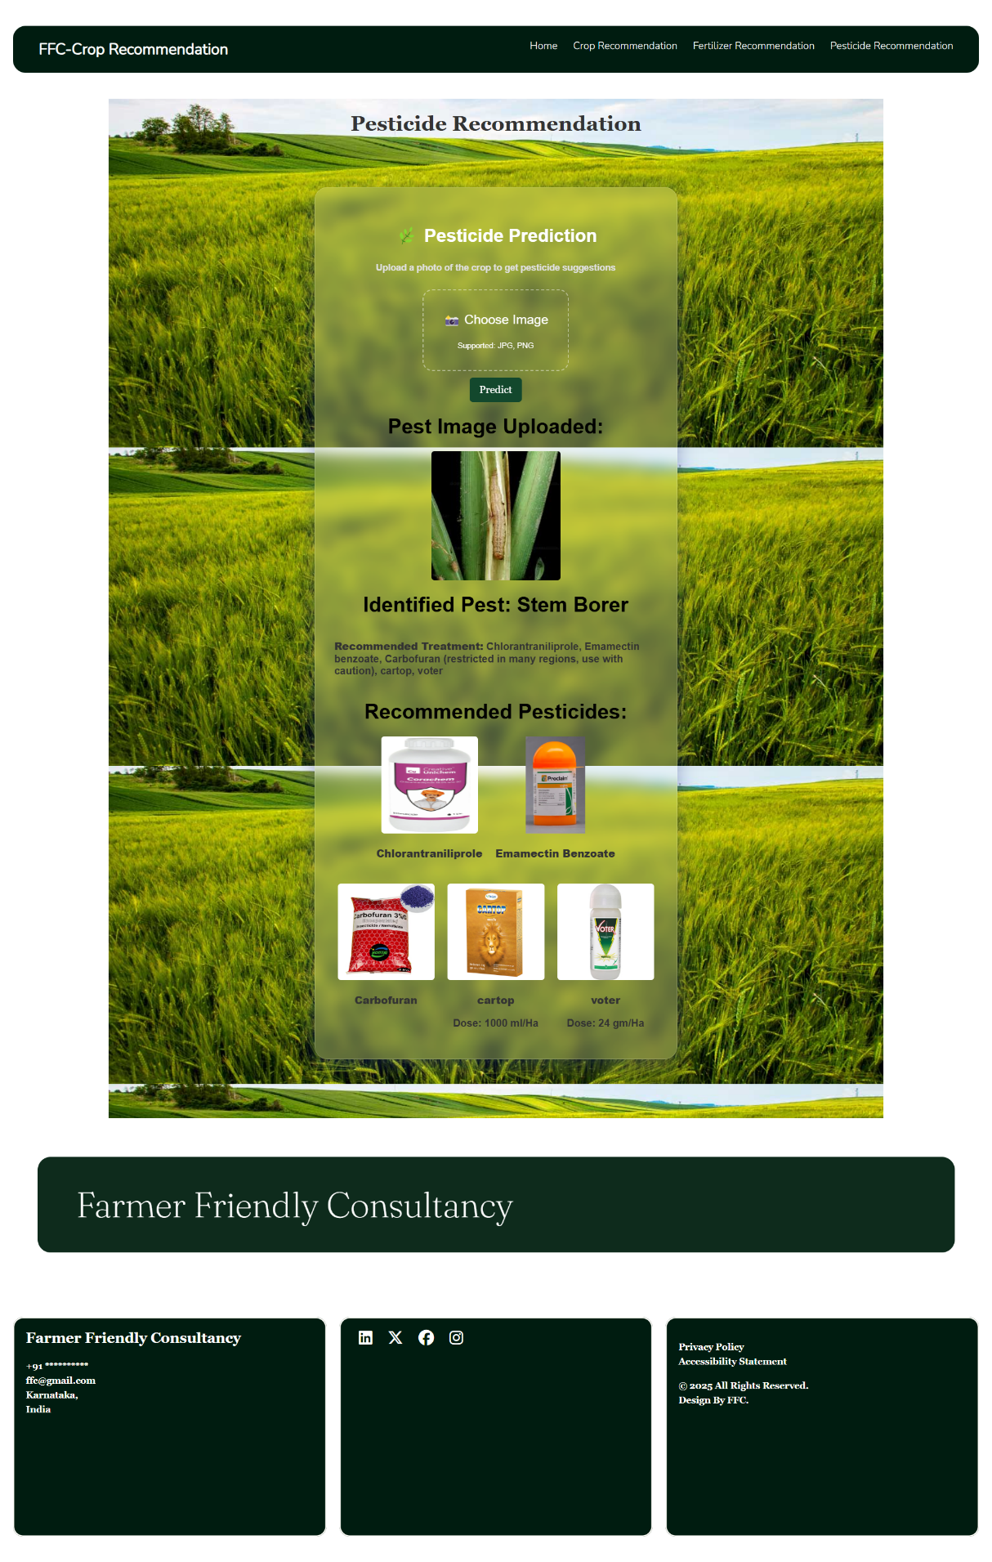
Results & Inference
Crop Recommendation Output
Fertilizer Recommendation
Pesticide Recommendation

Slide 16
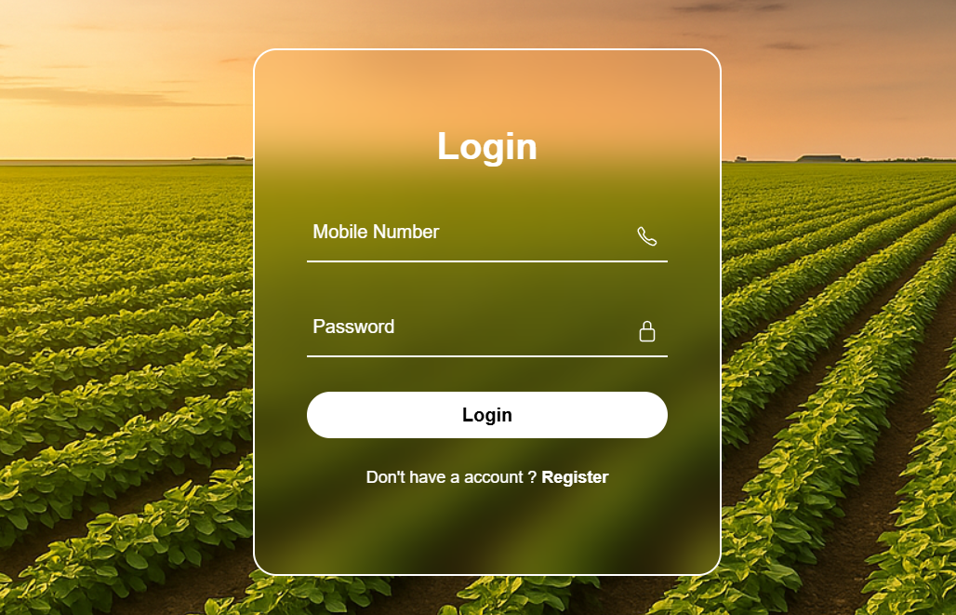
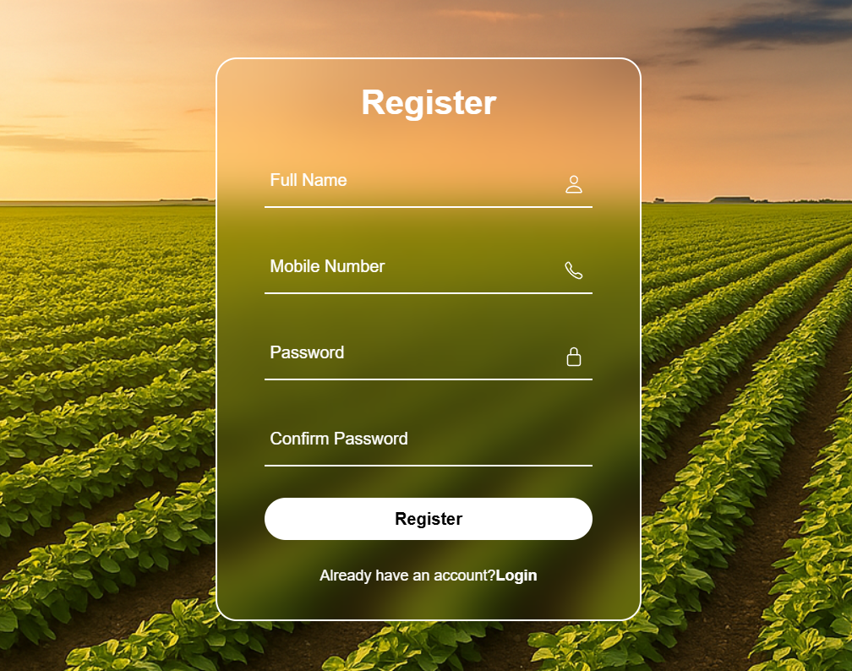
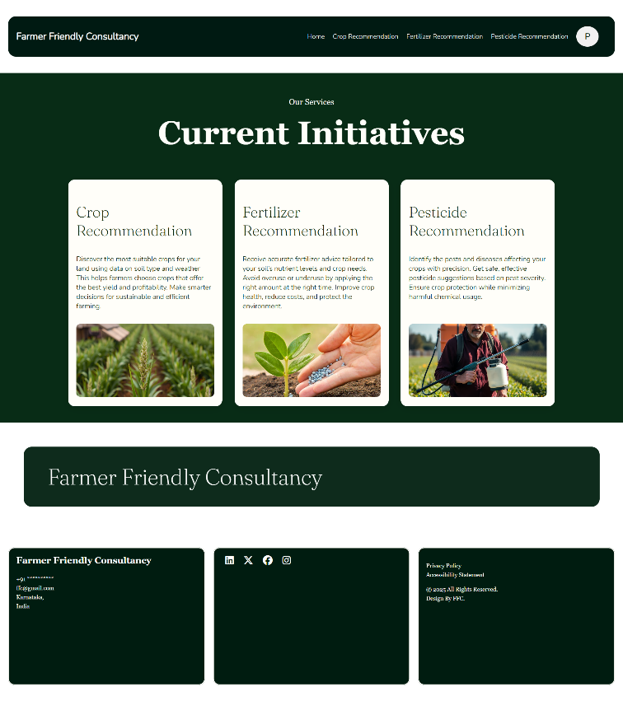
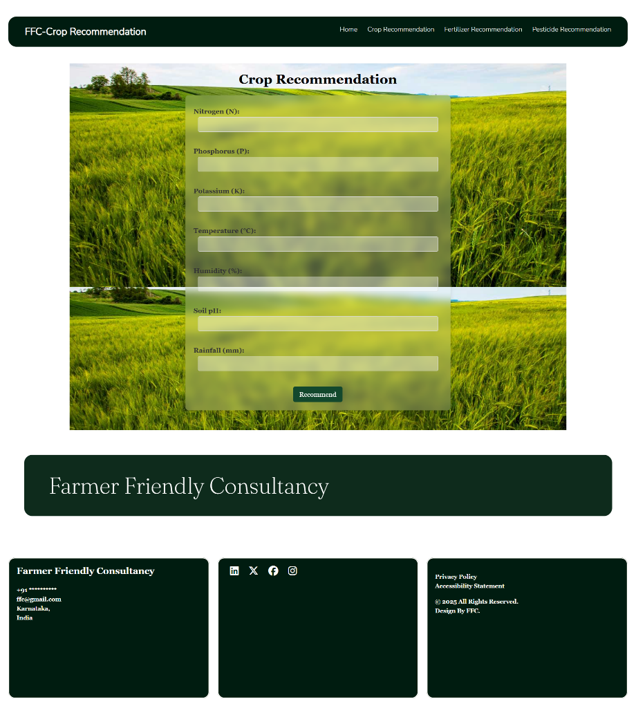
Login Page
Registration Page
Home Page
Crop Recommendation

Slide 17
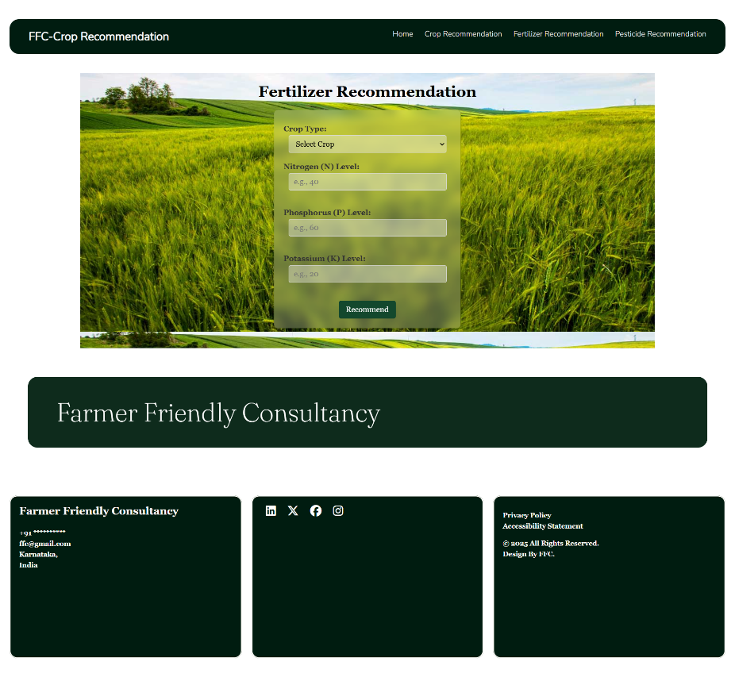
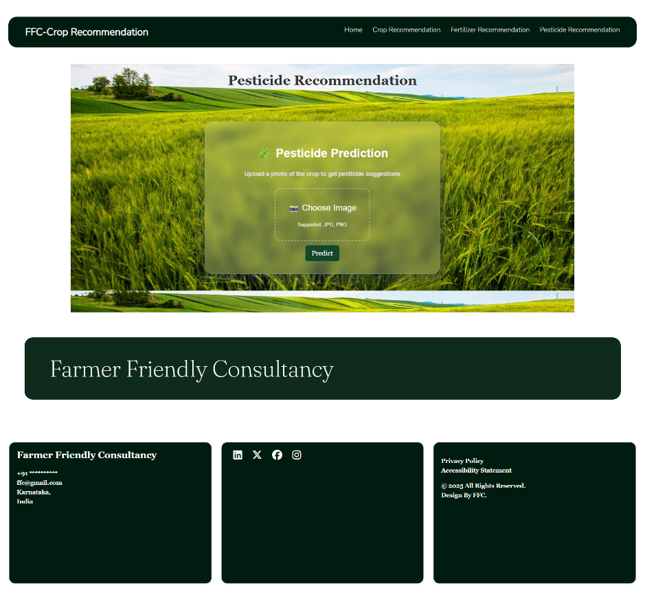
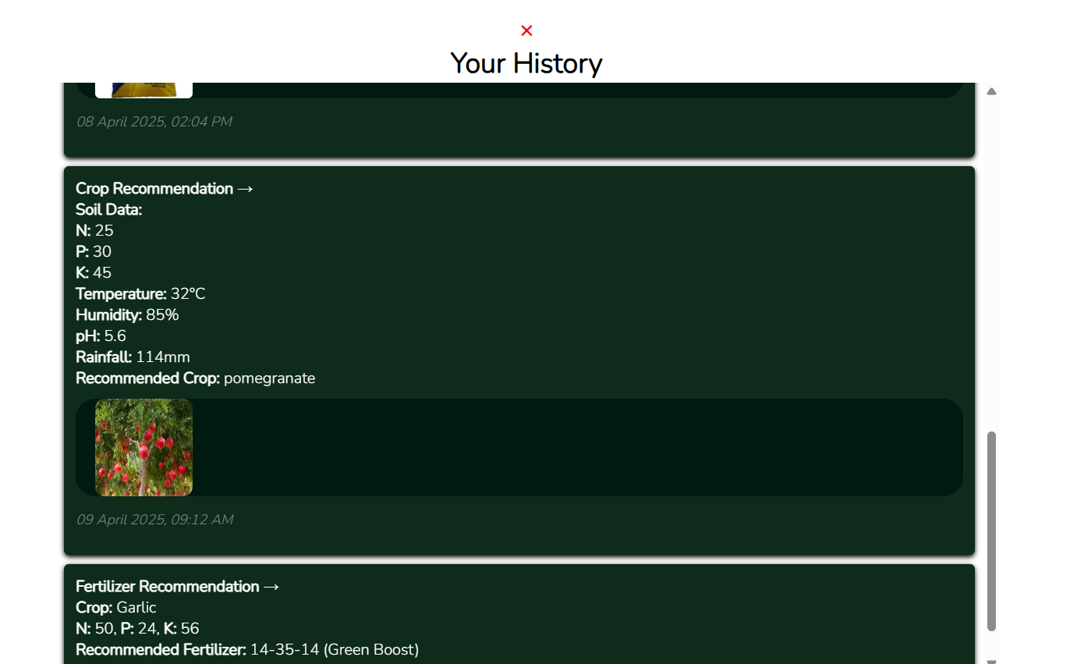
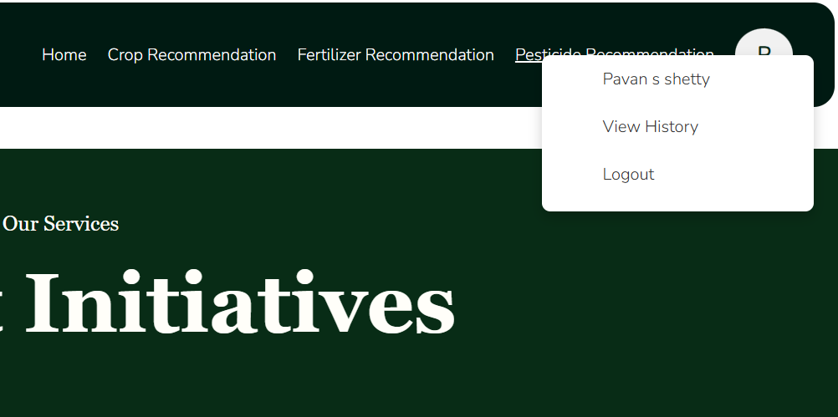
Pesticide Recommendation
Fertilizer Recommendation

Slide 18
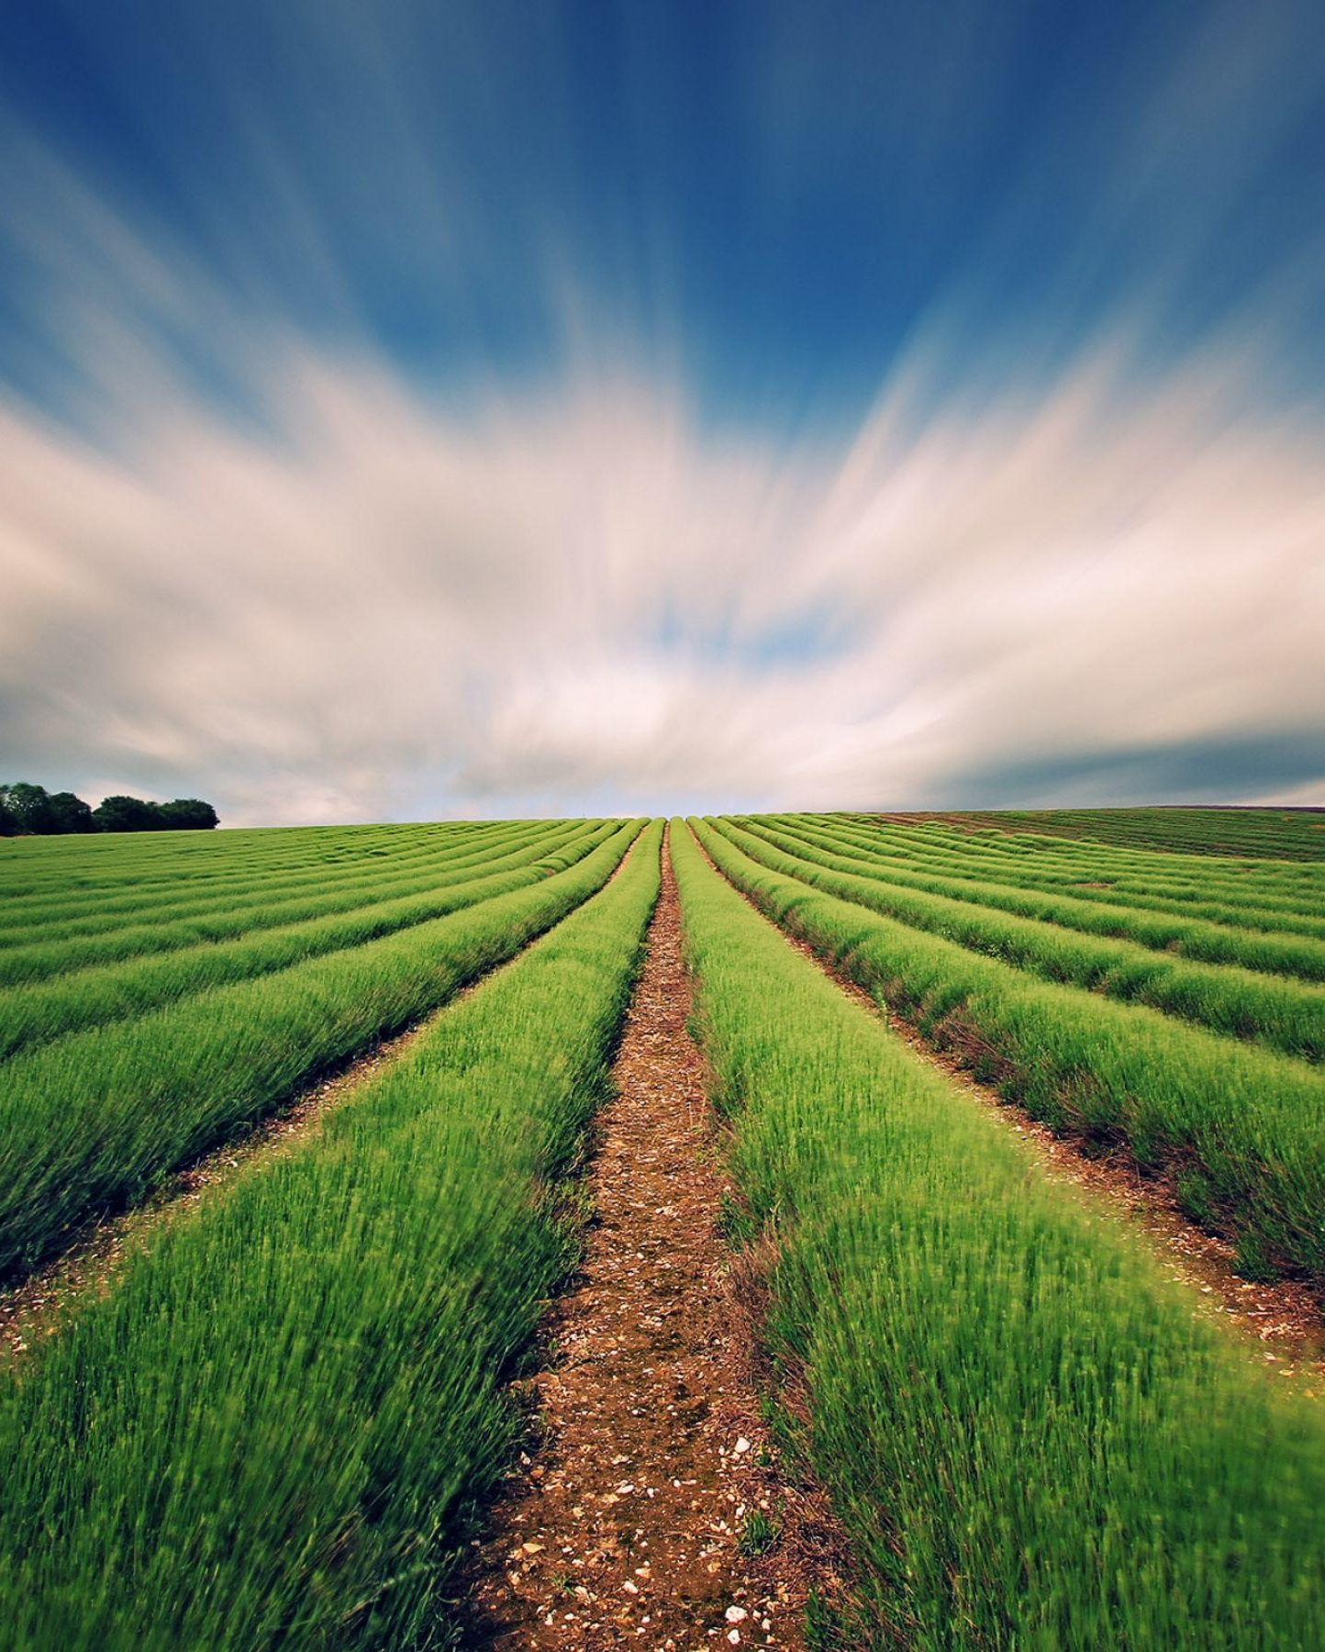
Conclusion
The project successfully delivers a smart, user-friendly platform for crop, fertilizer, and pesticide recommendations using machine learning. With features like history tracking and image-based input, it supports sustainable and informed farming practices.

Slide 19
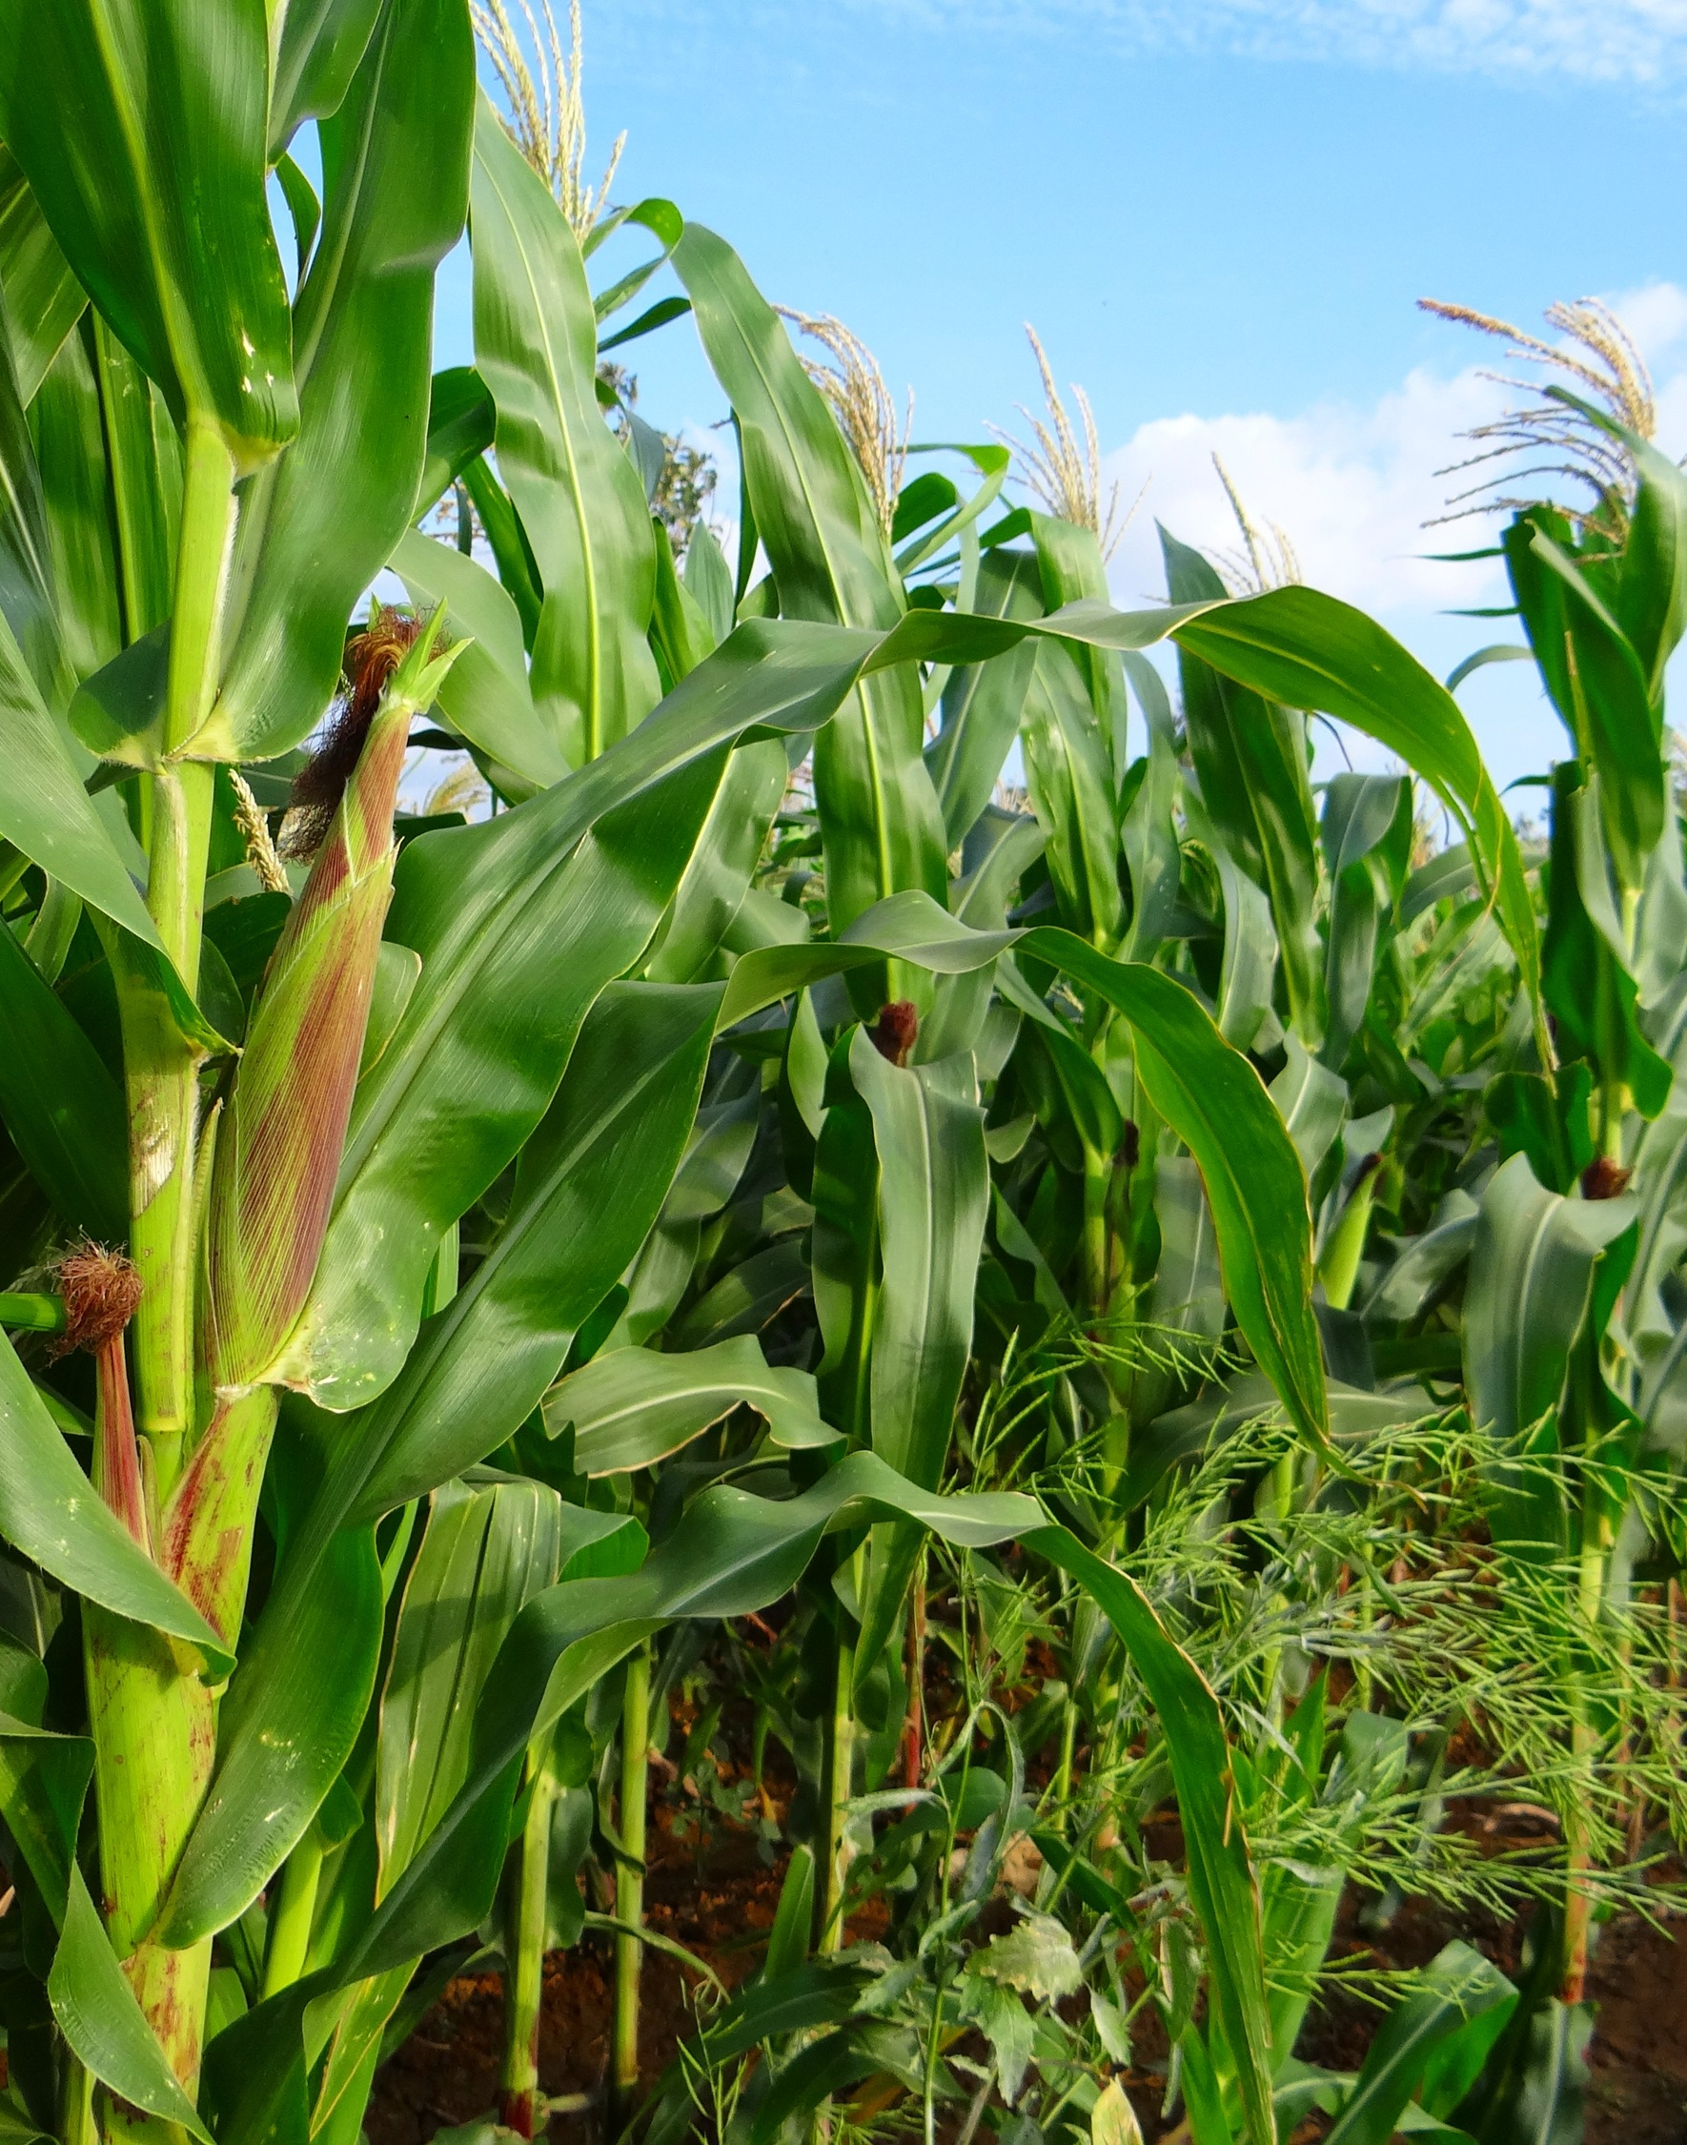
Future Scope
Multilingual Support: Introduce local language interfaces for accessibility.
Offline Mode: Add functionality for offline use with sync-on-connect.
Model Accuracy: Fine-tune ML models with larger datasets.
Voice Input: Enable speech-to-text for farmers with literacy limitations.
IoT Integration: Connect with soil sensors and drones for live environmental readings.

Slide 20
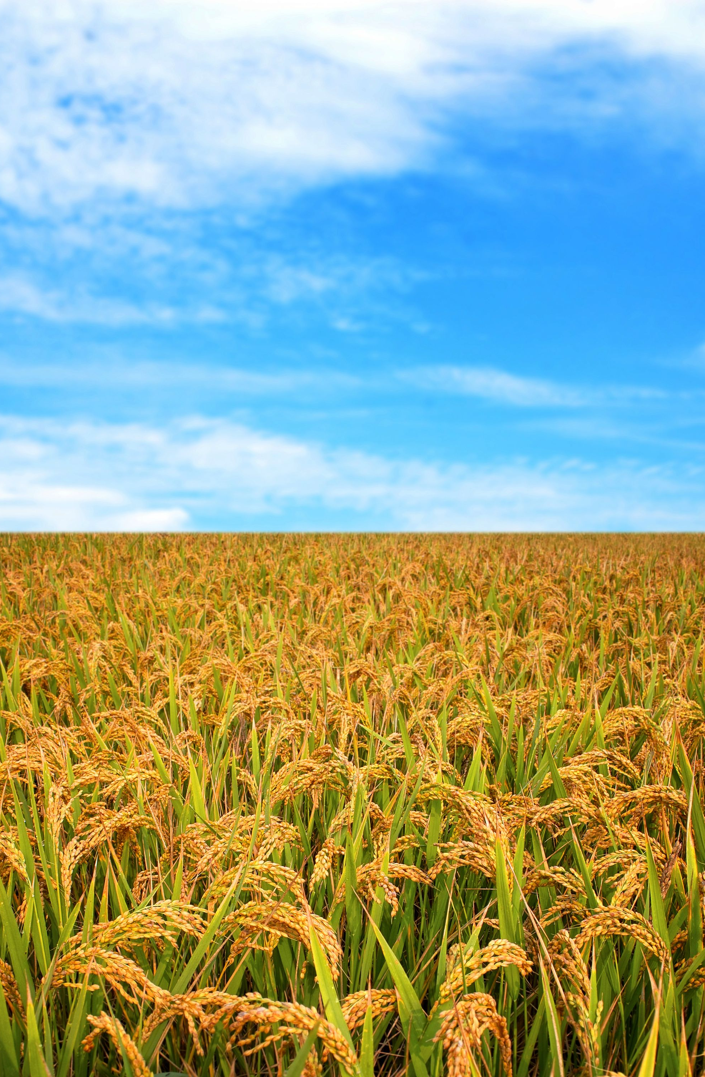
References
Academic Papers & Research Studies
Singh, A., Sharma, A., & Jain, V. (2021). AI-Powered Solutions for Indian Agriculture: A Review. International Journal of Agricultural Sciences.
Jadhav, R. et al. (2020). Pest Detection using Deep Learning: A Study on Image Classification Models. Journal of Agricultural Informatics.
Dahiya, P. & Meena, R. (2019). Fertilizer Recommendation System Based on Soil Parameters. International Conference on Data Science.
Industry Reports & Market Research
Ministry of Agriculture & Farmers Welfare (India). Annual Agriculture Report 2023.
NASSCOM & Accenture. (2022). Agritech in India: Emerging Trends & Outlook.
Statista. (2023). India: Smartphone Penetration and Agritech Market Statistics.
AgFunder. (2022). India Agritech Investment Report.
PwC Report (2021). Digital Agriculture in India: Unlocking the Potential of AI.
Technology & Open-Source Tools Used
Flask Framework – Micro web framework used to build the application.
Source: https://flask.palletsprojects.com
TensorFlow & Keras – For deep learning model training and prediction.
Source: https://www.tensorflow.org
Pandas, NumPy, PIL – For data processing, numerical operations, and image handling.
MongoDB – NoSQL database used to store user history and recommendations.
Source: https://www.mongodb.com
Bootstrap CSS & Font Awesome – Used for responsive UI and icons.

Slide 21

Thank you
Farmer Friendly Consultancy

